Slide 1
PYTHON WEB FRAMEWORK
By,
SHAIKH JASMINE KAUSER

Slide 2
TOPICS WHICH WE LEARN:
DJANGO
WEB2PY
CHERRYPY

Slide 3
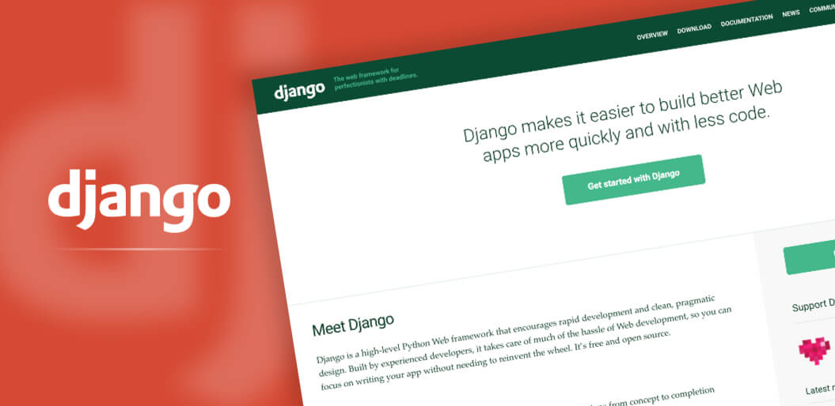
As we are discussing about Frameworks so here we start with the First
Django:
It is free and open-source that enables developers to develop complex code and effective applications.
It is extremely popular and fully featured server-side web framework, which is written in python.
it include “Batteries =included” Philosophy its size is 8.6mb.
The Author of Framework is Andrian Holovaty, Simon Willison.

Slide 4
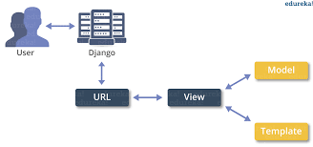
Architecture of Django
It Follows Model View Controller (MVC)

Slide 5
Requirements:
1. Python:3.5, 3.6, 3.7
2. Django:1.11,2.0,2.1,2.2
3. MySQL: 5.6,5.7/ MariaDB:10.0,10.1,10.2,10.3
4. mysqlclient:1.3
Advantages:
1. Written in Python.
2. Provides Robust Security Features.
3. Supported by Large and Active Community.
Disadvantages:
1. Impact performance of Web Applications.
2. Make Web Application Tightly-Coupled.

Slide 6
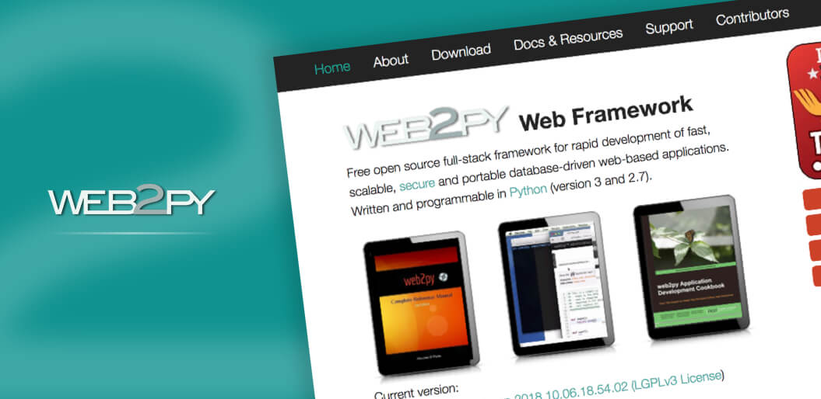
2. Web2Py:
It was originally designed as a teaching tool with emphasis on ease of use and deployment.
It is an Open-Source web application framework written in the Python Programming Language.
It allows web developers to program dynamic web content using Python.
It is full-stack framework in that it has built-in components for all major functions.

Slide 7
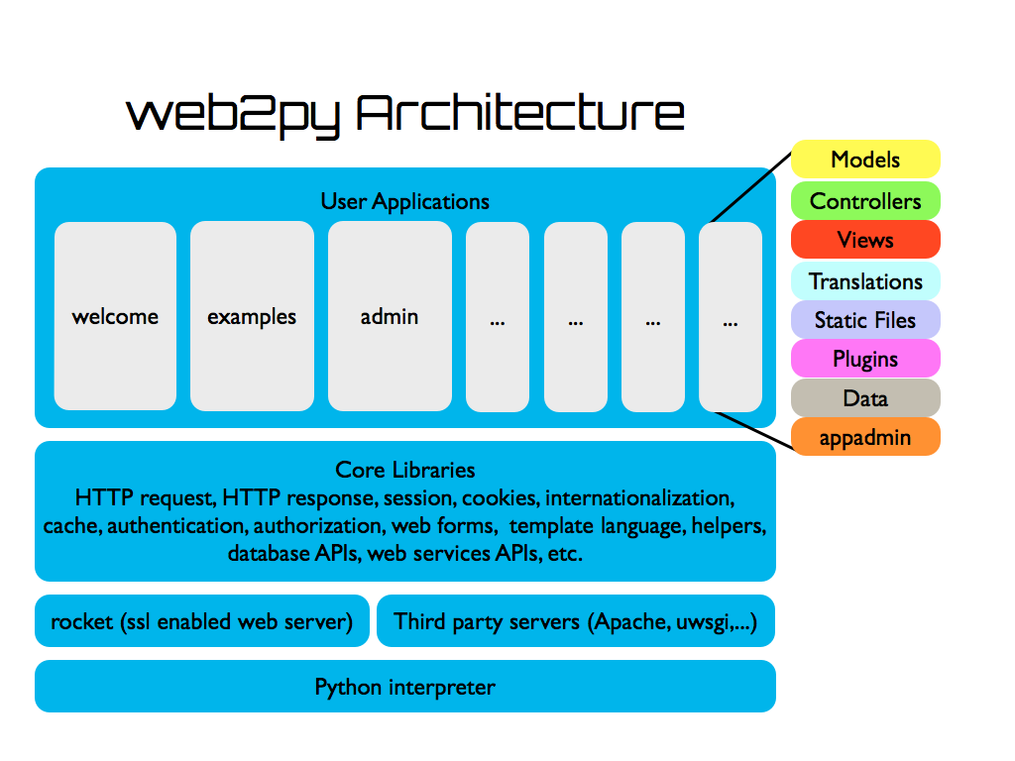
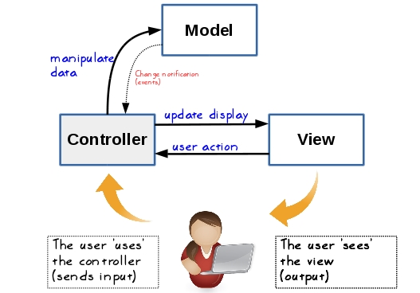
Architecture of Web2Py
It Follows MVC Architecture

Slide 8
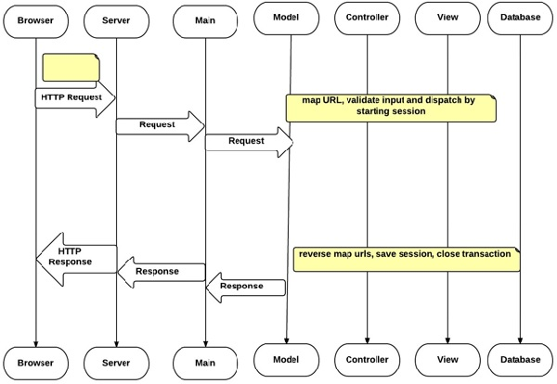
Workflow of Web2Py
Advantages:
1. Web-Based IDE/Admin.
2. Built-in Ajax Support and Ajax Components.
3. Regular Pythons in views/templates.

Slide 9
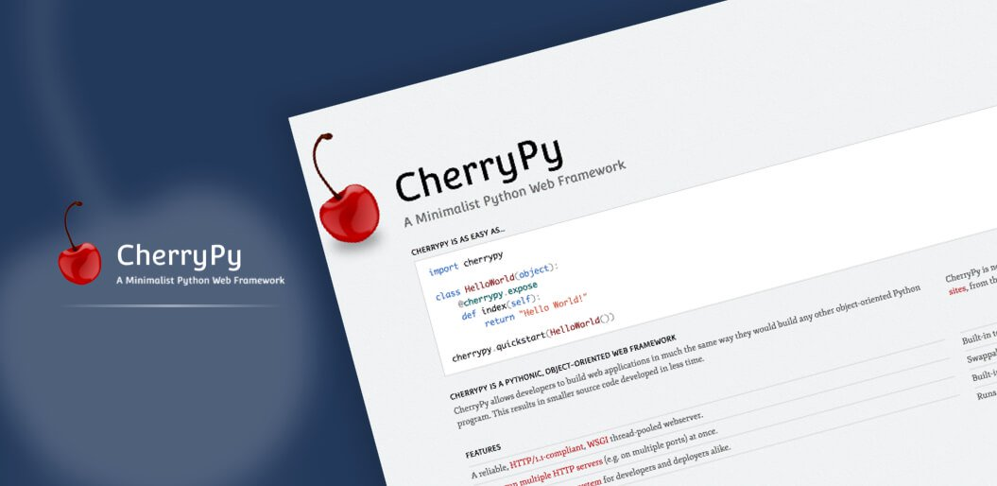
3. Cherrypy
It is an Object-Oriented web application Framework using the python programming language.
It is designed for rapid development of web applications by Wrapping the HTTP protocol.

Slide 10
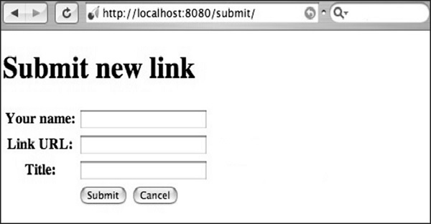
Architecture of CherryPy
CherryPy is a web framework of Python which provides a friendly interface to the HTTP protocol for python developers.
It is also called a web application Library.

Slide 11
Features:
1. Simplicity.
2. It is completely Free and Open Source.
3. Powerful.
4. Built-in-webserver.

